Slide 1
DATA ANALYTICS

Slide 2
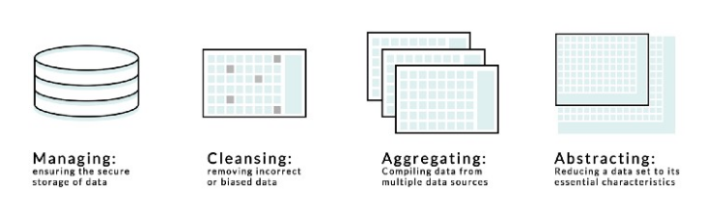
Different roles of Data analytics

Slide 3
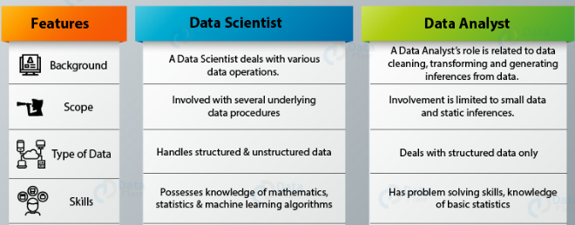
Data Science and Data Analytics.

Slide 4
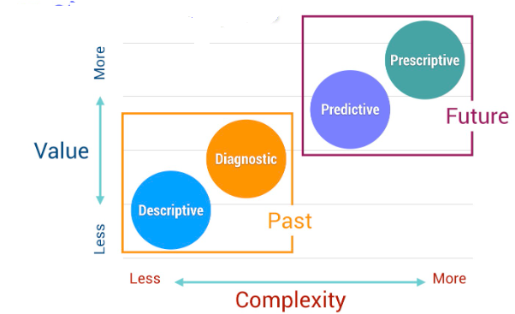
Data Analytics

Slide 5
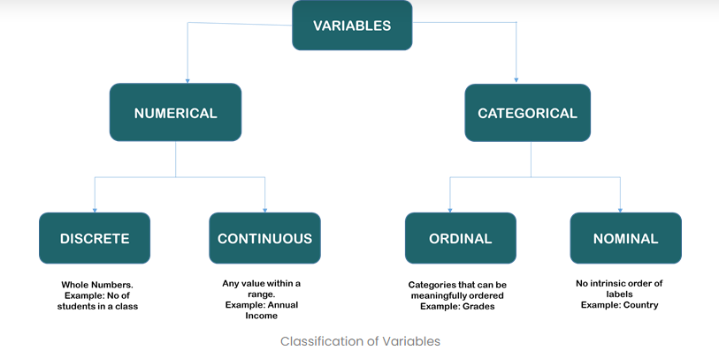
Identification of variables

Slide 6
        Measurement Scales
  Interval Scale
    Data classified by ranking.
    Quantitative classification (time, temperature, etc).
    Zero point of scale is arbitrary (differences are meaningful).
  Ratio Scale
    Data classified as the ratio of two numbers.
    Quantitative classification (height, weight, distance, etc).
    Zero point of scale is real (data can be added, subtracted, multiplied, and divided).

Slide 7
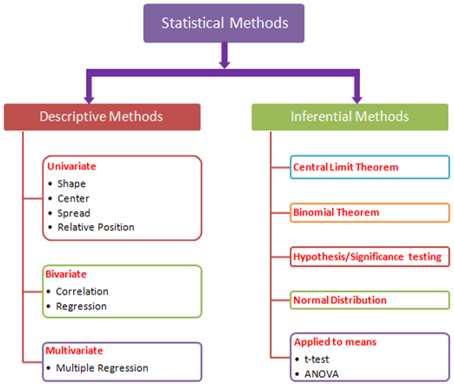

Slide 8
Summary Measures
Summary Measures
Central Tendency
Quartiles
Variation
Mean
Mode
Median
Range
Coefficient of Variation
Variance
Standard Deviation
Geometric Mean

Slide 9
Central Tendency and Measures of dispersion

Slide 10
Measures of central tendency
Yield information about particular places or locations in a group of numbers.
That is a single number to describe the characteristics of a set of data.

Slide 11
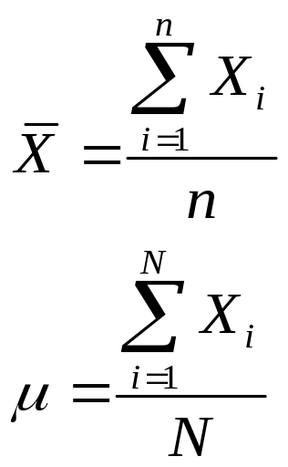
Measures of Central Tendency
Central Tendency
Mean
Median
Mode
Geometric Mean

Slide 12
Arithmetic mean
Commonly it is called as the mean it is the average of a group of numbers; it is applicable for interval and ratio data.
Not applicable for nominal and ordinal data.
It is affected by each value in the data set including extreme values, one of the problem of the with the mean is that it is affected by the extreme values computed by summing all values in the data set and dividing the sum by the number of values in the data set.

Slide 13
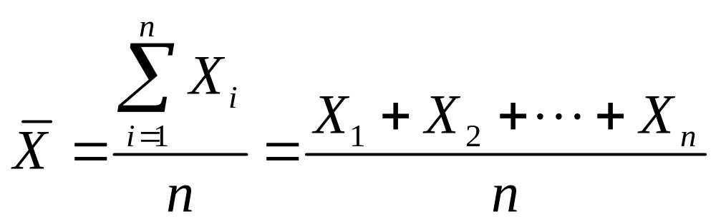
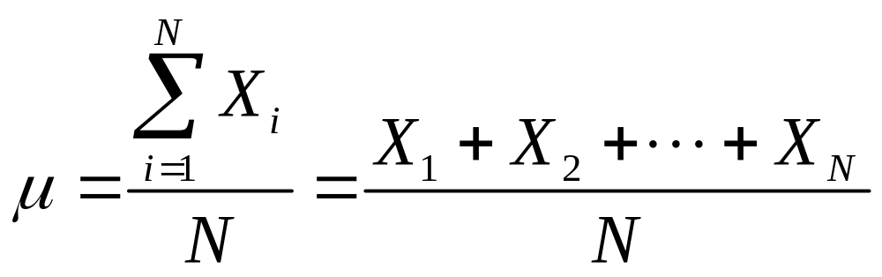
Mean (Arithmetic Mean)
Mean (Arithmetic Mean) of Data Values
  Sample mean
  Population mean
Sample Size
Population Size

Slide 14
Mean (Arithmetic Mean)
(continued)
The Most Common Measure of Central Tendency
Affected by Extreme Values (Outliers)
0 1 2 3 4 5 6 7 8 9 10
0 1 2 3 4 5 6 7 8 9 10 12 14
Mean = 5
Mean = 6

Slide 15
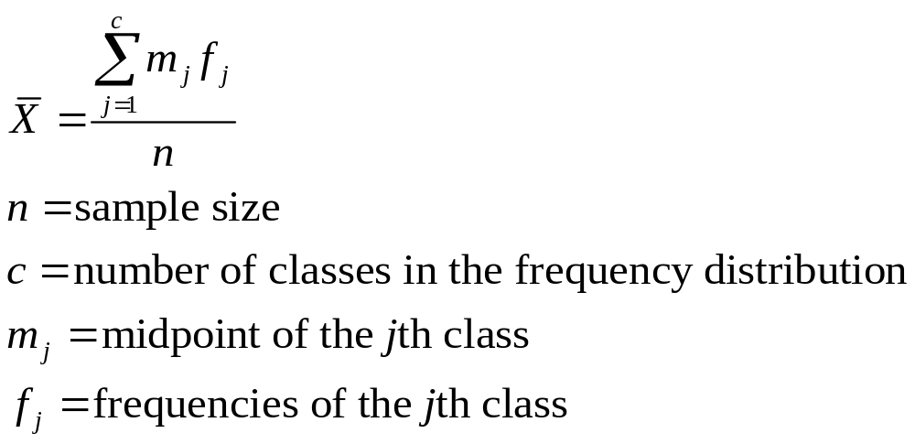
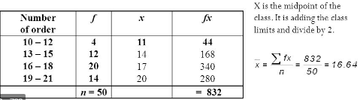
Mean (Arithmetic Mean)
From a Frequency Distribution
Approximating the Arithmetic Mean
  Used when raw data are not available

Slide 16
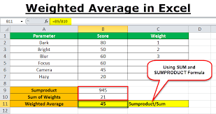
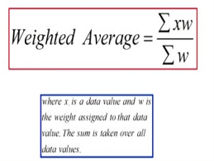
Weighted average

Slide 17
Median
Median, the middle value in ordered array of number is called Median. It is applicable for ordinal interval and ratio data.
It is not applicable for nominal data and one advantage of median is it is unaffected by extremely large and extremely small values.

Slide 18
Median
Robust Measure of Central Tendency
Not Affected by Extreme Values
In an Ordered Array, the Median is the ‘Middle’ Number
  If n or N is odd, the median is the middle number
  If n or N is even, the median is the average of the 2 middle numbers
0 1 2 3 4 5 6 7 8 9 10
0 1 2 3 4 5 6 7 8 9 10 12 14
Median = 5
Median = 5

Slide 19
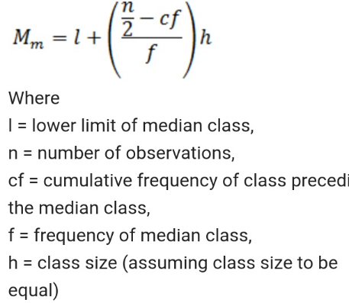
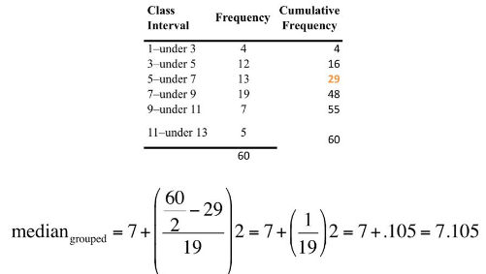
Median of grouped data

Slide 20
Mode
The most frequently occurring value in a data set is mode applicable to all level of data, measurement nominal, ordinal, interval and ratio.
Sometimes there is a possibility the data set may be bimodal.
Bimodal means data sets that have two modes. That means two numbers are repeated same number of time multimodal data sets that contain more than two modes.

Slide 21
Mode
A Measure of Central Tendency
Value that Occurs Most Often
Not Affected by Extreme Values
There May Not Be a Mode
There May Be Several Modes
Used for Either Numerical or Categorical Data
0 1 2 3 4 5 6
0 1 2 3 4 5 6 7 8 9 10 11 12 13 14
No Mode
Mode = 9

Slide 22
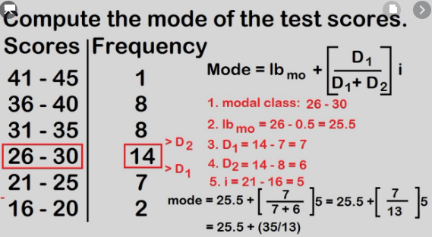

Slide 23
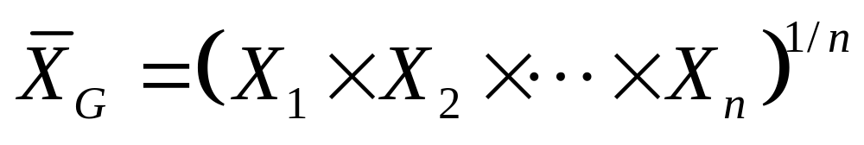
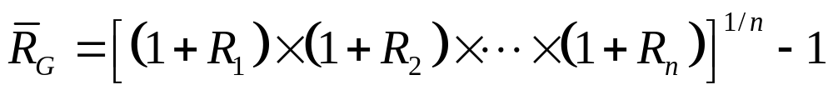
Geometric Mean
Useful in the Measure of Rate of Change of a Variable Over Time
Geometric Mean Rate of Return
  Measures the status of an investment over time

Slide 24
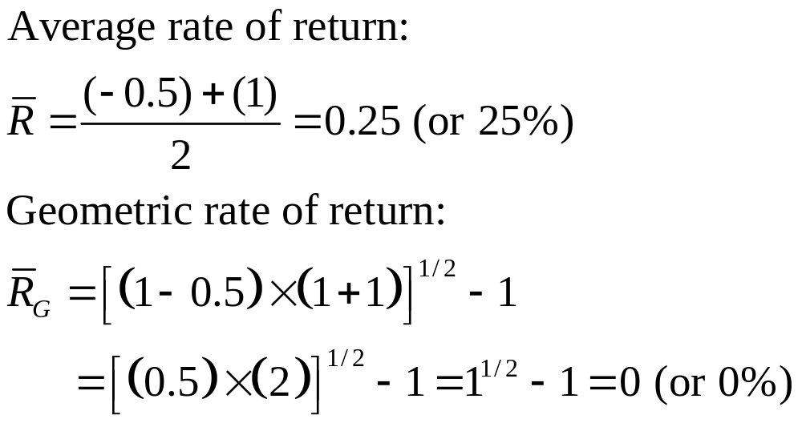
Example
An investment of $100,000 declined to $50,000 at the end of year one and rebounded back to $100,000 at end of year two:

Slide 25
Percentiles
Divide a group of data into 100 parts it is called percentile.
For example; somebody say 90th percentile my score is 90th percentile indicates that at most 90% of the data lie below it and at least 10% the data lie above it.
The median and the 50th percentile have the same value. It is applicable for ordinal, interval and ratio data it is not applicable for nominal data.

Slide 26
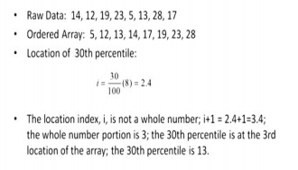

Slide 27
Dispersion
Describes the spread or the dispersion of the set of the data.
The reliability of measure of central tendency is the dispersion because many times, the central tendency will mislead the people.
So the reliability of that central tendency is calculated by or identified by its corresponding dispersion.

Slide 28
Measures of Variation
Variation
Range
Variance
Standard Deviation
Coefficient of Variation
Interquartile Range
Population
Variance
Population
Standard
Deviation
Sample
Variance
Sample
Standard
Deviation

Slide 29
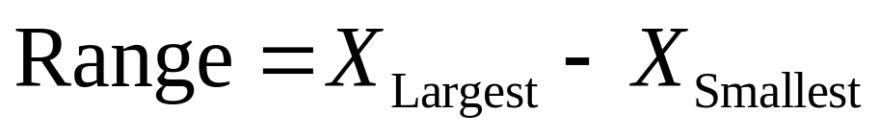
Range
Measure of Variation
Difference between the Largest and the Smallest Observations:
Ignores How Data are Distributed
Range = 12 - 7 = 5
Range = 12 - 7 = 5
7 8 9 10 11 12
7 8 9 10 11 12

Slide 30
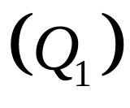
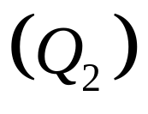
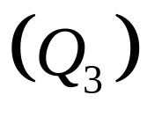
Quartiles
Split Ordered Data into 4 Quarters
25%
25%
25%
25%
Data in Ordered Array: 11 12 13 16 16 17 18 21 22

Slide 31
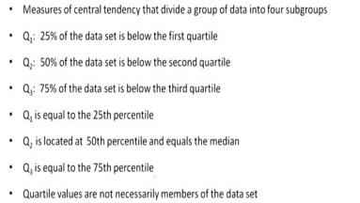

Slide 32
Find a quartile by determining the value in the appropriate position in the ranked data, where
First quartile position: Q₁ = (n+1)/4 ranked value
Second quartile position: Q₂ = (n+1)/2 ranked value
Third quartile position: Q₃ = 3(n+1)/4 ranked value
where n is the number of observed values

Slide 33
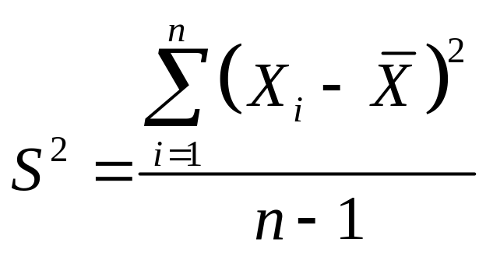
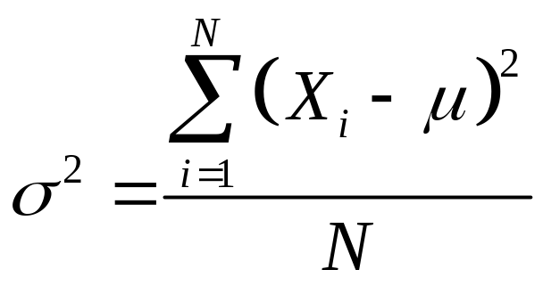
Variance
Important Measure of Variation
Shows Variation about the Mean
  Sample Variance:
  Population Variance:

Slide 34
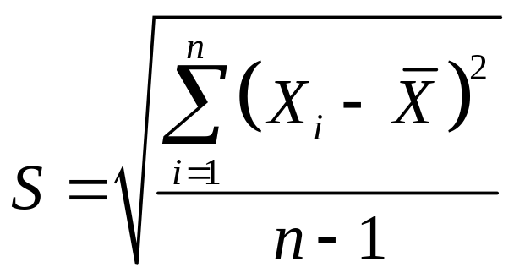
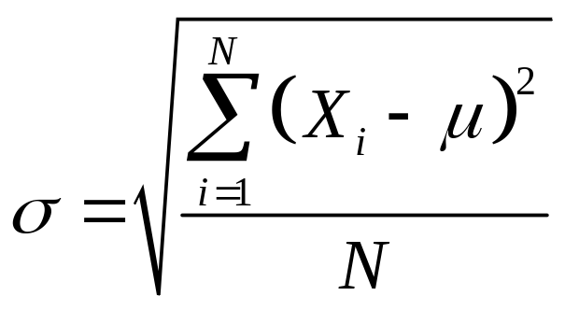
Standard Deviation
Most Important Measure of Variation
Shows Variation about the Mean
Has the Same Units as the Original Data
  Sample Standard Deviation:
  Population Standard Deviation:

Slide 35
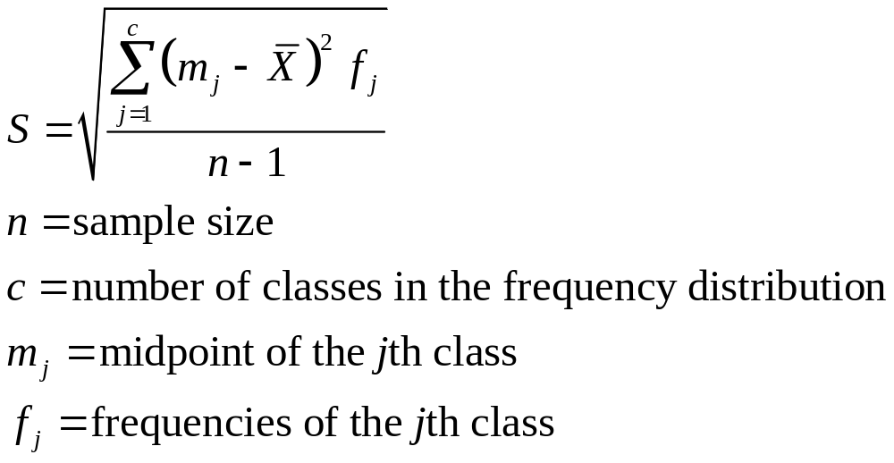
Standard Deviation
From a Frequency Distribution
(continued)
Approximating the Standard Deviation
  Used when the raw data are not available and the only source of data is a frequency distribution

Slide 36
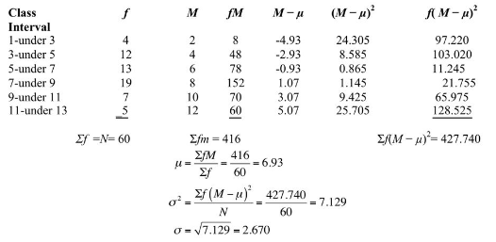
Variance and standard deviation of the grouped data

Slide 37
Measures of Dispersion:
Summary Characteristics
The more the data are spread out, the greater the range, variance, and standard deviation.
The less the data are spread out, the smaller the range, variance, and standard deviation.
If the values are all the same (no variation), all these measures will be zero.
None of these measures are ever negative.

Slide 38
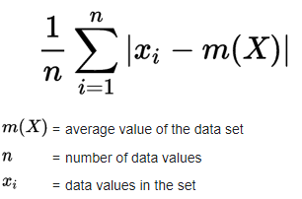
Mean absolute deviation (MAD)
The mean absolute deviation of a dataset is the average distance between each data point and the mean. It gives us an idea about the variability in a dataset.

Slide 39
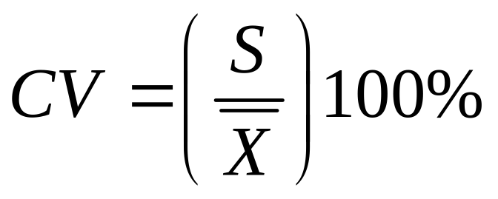
Coefficient of Variation
Measure of Relative Variation
Always in Percentage (%)
Shows Variation Relative to the Mean
Used to Compare Two or More Sets of Data Measured in Different Units
Sensitive to Outliers

Slide 40
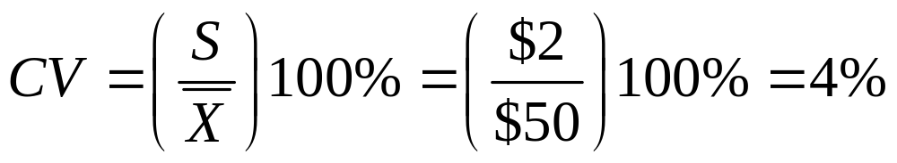
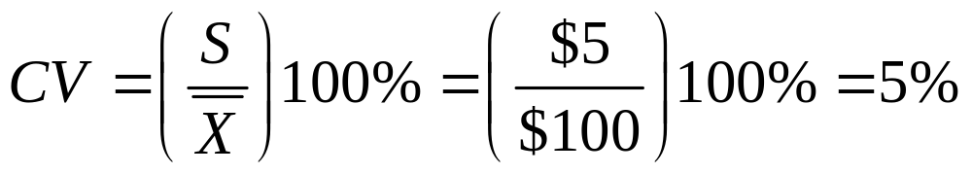
Comparing Coefficient of Variation
Stock A:
  Average price last year = $50
  Standard deviation = $2
Stock B:
  Average price last year = $100
  Standard deviation = $5
Coefficient of Variation:
  Stock A:
  Stock B:

Slide 41
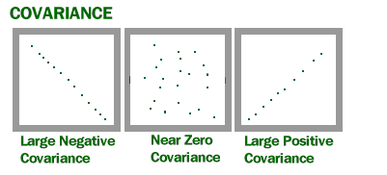
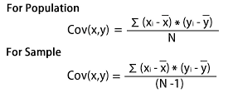
Covariance
Covariance is a measure of how much two random variables vary together. It’s similar to variance, but where variance tells you how a single variable varies, co variance tells you how two variables vary together.

Slide 42
John is an investor. His portfolio primarily tracks the performance of the S&P 500 and John wants to add the stock of ABC Corp. Before adding the stock to his portfolio, he wants to assess the directional relationship between the stock and the S&P 500.
John does not want to increase the unsystematic risk of his portfolio. Thus, he is not interested in owning securities in the portfolio that tend to move in the same direction.
John can calculate the covariance between the stock of ABC Corp. and S&P 500 by following the steps below

Slide 43
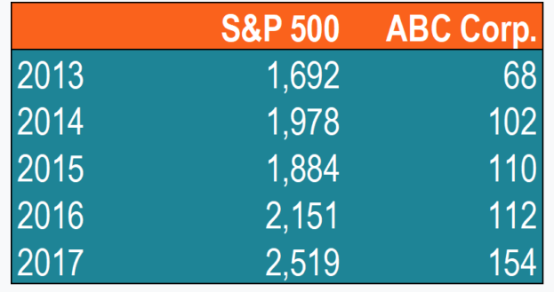
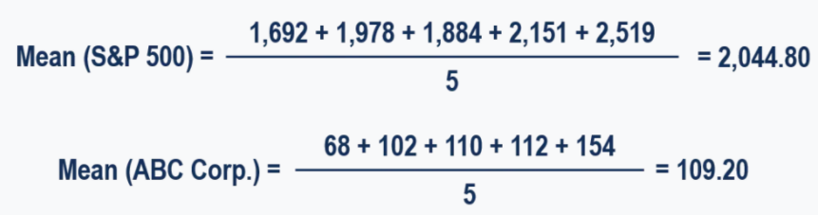
1. Obtain the data.
First, John obtains the figures for both ABC Corp. stock and the S&P 500. The prices obtained are summarized in the table below:
2. Calculate the mean (average) prices for each asset.

Slide 44
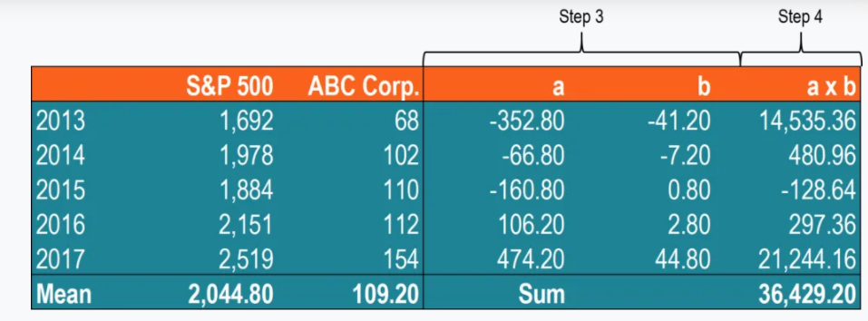
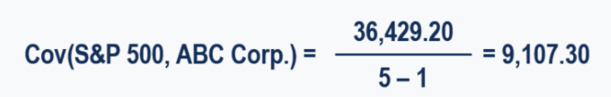
3. For each security, find the difference between each value and mean price.
4. Multiply the results obtained in the previous step.
5. Using the number calculated in step 4, find the covariance.
In such a case, the positive covariance indicates that the price of the stock and the S&P 500 tend to move in the same direction.

Slide 45
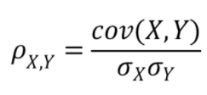
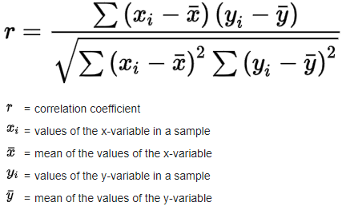
Correlation
The main problem with interpretation is that the wide range of results that it takes on makes it hard to interpret.
Correlation coefficients are used to measure how strong a relationship is between two variables.
There are several types of correlation coefficient, but the most popular is Pearson’s. Pearson’s correlation (also called Pearson’s R) is a correlation coefficient commonly used in linear regression.

Slide 46
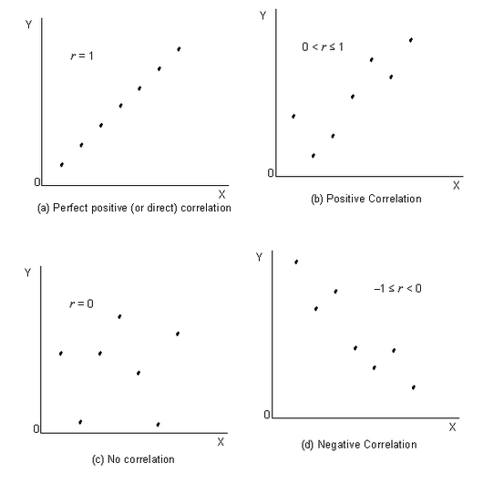
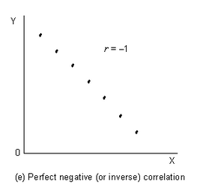
Correlation coefficient formulas are used to find how strong a relationship is between data. The formulas return a value between -1 and 1, where:
1 indicates a strong positive relationship.
-1 indicates a strong negative relationship.
A result of zero indicates no relationship at all.

Slide 47
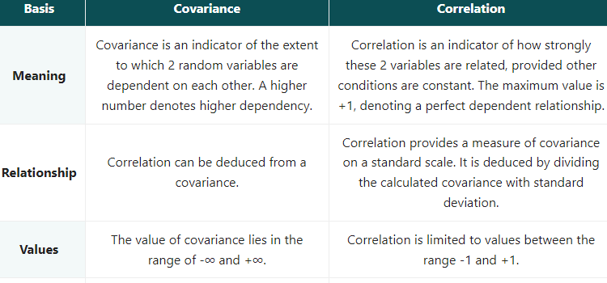

Slide 48
Measures of shape
Skewness
absence of symmetry
kurtosis
the peakedness of a distribution.
There are three layers, there are Leptokurtic, Mesokurtic, Platykurtic.
box and whisker plots
It is a graphical display of distribution.
It reveals skewness.

Slide 49
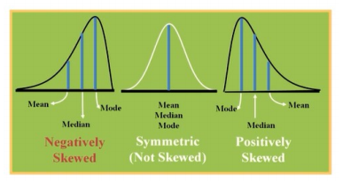
Skewness
Skewness, in statistics, is the degree of distortion from the symmetrical bell curve in a probability distribution.
Distributions can exhibit right (positive) skewness or left (negative) skewness to varying degrees.

Slide 50
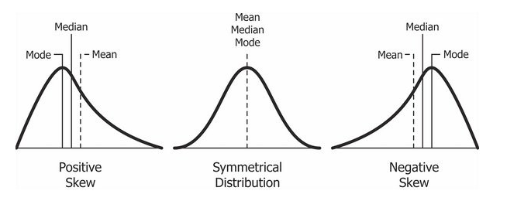
Measures of Skewness
O If Mean > Mode, the skewness is positive.
O If Mean < Mode, the skewness is negative.
O If Mean = Mode, the skewness is zero.

Slide 51
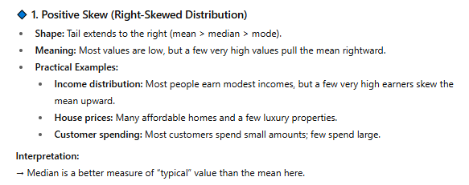
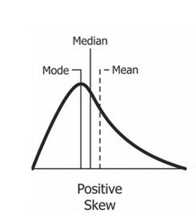
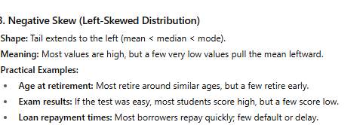


Slide 52

Coefficient of skewness

Slide 53


Kurtosis (Ku)
Measure of relative peakedness of a distribution. It is a shape parameter that characterizes the degree of peakedness.

Slide 54


Normal distribution
Skewness = 0
Kurtosis = 3

Slide 55


Slide 56
The Empirical Rule
For Data Sets That Are Approximately Bell-shaped:
  Roughly 68% of the Observations Fall Within 1 Standard Deviation Around the Mean
  Roughly 95% of the Observations Fall Within 2 Standard Deviations Around the Mean
  Roughly 99.7% of the Observations Fall Within 3 Standard Deviations Around the Mean

Slide 57

The Empirical Rule

Slide 58


Slide 59
Example
The weights of stray dogs at a particular pound average 70 lbs with a standard deviation of 2.5 lbs. Assuming the weights follow a Gaussian distribution:
What weight is 2 standard deviations below the mean?
What weight is 1 standard deviation above the mean?
The middle 68% of dogs weigh how much?

Slide 60
2 standard deviations is 2 * 2.5 (5 lbs). So if a dog is 2.5 standard deviations below the mean they weigh 70 lbs – 5 lbs = 65 lbs.
1 standard deviation is 2.5 lbs, so a dog 1 standard deviation above the mean would weigh 70 lbs + 2.5 lbs = 72.5 lbs.
The 68 95 99.7 Rule tells us that 68% of the weights should be within 1 standard deviation either side of the mean. 1 standard deviation above (given in the answer to question 2) is 72.5 lbs; 1 standard deviation below is 70 lbs – 2.5 lbs is 67.5 lbs. Therefore, 68% of dogs weigh between 67.5 and 72.5 lbs.

Slide 61



Exploratory Data Analysis
Box-and-Whisker Plot
  Graphical display of data using 5-number summary
Median( )
X
X
smallest
largest
4
6
8
10
12

Slide 62


Distribution Shape &
Box-and-Whisker Plot
Left-Skewed
Symmetric
Right-Skewed

Slide 63

Identifying outliers with the 1.5xIQR rule
Find the median, quartiles, and interquartile range

Slide 64




